Slide 1


Spatial Machine Learning
Introduction to Spatial Data and Machine Learning
Dr. Giri Rajasekhar Gunnu
Professor of Practice, Andhra University
📧 g.giri.iitm@gmail.com
🔗 LinkedIn: girigunnu

Slide 2
Introduction
1

Slide 3
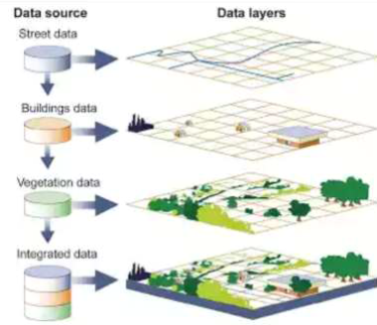
Introduction
Geographic Information System is an integrated system of computer Hardware and Software, coupled with procédures and human analyst which together support the capture, management, manipulation, analysis, modelling and display of spatially referenced data.
GIS can store many different types of data on one map.
This enables people to more easily see, analyze and understand patterns and relationships

Slide 4
What is a Geographic Information System?
Geographic Information System (GIS) – A computer-based system for the collection, storage, organization, maintenance, and analysis of spatially-referenced data, and the output of spatially-referenced information.
Data – Any collection of related facts; the basic elements of information.
Information - Data that have been processed to be useful; provides answers to "who", "what", "where", and "when" questions
Information can only come from accurate data.

Slide 5
What is Spatial Analysis?
Adistinction is made in this course between GIS and spatial analysis. In mainstream GIS software, the term analysis typically refers to operations such as data manipulation and querying.
In contrast, spatial analysis focuses on the statistical examination of spatial patterns and the processes that may have generated them.
More broadly, spatial analysis seeks to answer questions like: “What could have caused the observed spatial pattern?” It is an exploratory process in which we quantify spatial patterns and investigate the underlying mechanisms that may explain their distribution.

Slide 6
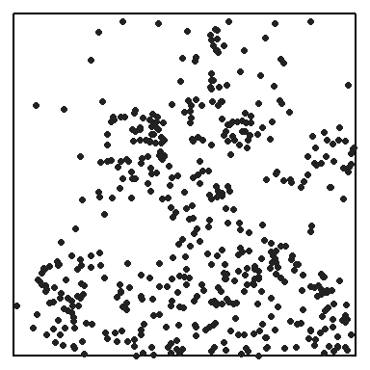
What is Spatial Analysis?
For example, imagine you record the location of each tree within a well-defined study area. Mapping these locations is a typical GIS task. Once the trees are mapped, you may begin to draw inferences about the spatial pattern: Are the trees clustered or dispersed? Is tree density consistent across the study area? Could environmental factors such as soil type or slope have influenced the observed distribution? These are the kinds of questions addressed through spatial analysis, using quantitative and statistical techniques to explore and explain spatial patterns.
Distribution of Maple trees in a 1,000 x 1,000 ft study area.

Slide 7
Applications of GIS
Urban Planning, Management & Policy
Zoning, subdivision planning
Land acquisition
Economic development
Code enforcement
Housing renovation programs
Emergency response
Crime analysis
Tax assessment

Slide 8
Applications of GIS
Environmental Sciences
Monitoring environmental risk
Modeling storm water runoff
Management of watersheds, floodplains, wetlands, forests, aquifers
Environmental Impact Analysis
Hazardous or toxic facility siting
Groundwater modeling and contamination tracking

Slide 9
Applications of GIS
Political Science
Redistricting
Analysis of election results
Predictive modeling

Slide 10
Applications of GIS
Civil Engineering/Utility
Locating underground facilities
Designing alignment for freeways, transit
Coordination of infrastructure maintenance

Slide 11
Applications of GIS
Business
Demographic Analysis
Market Penetration/ Share Analysis
Site Selection

Slide 12
Applications of GIS
Education Administration
Attendance Area Maintenance
Enrollment Projections
School Bus Routing

Slide 13
Applications of GIS
Real Estate
Neighborhood land prices
Traffic Impact Analysis
Determination of Highest and Best Use

Slide 14
Applications of GIS
Health Care
Epidemiology
Needs Analysis
Service Inventory

Slide 15
Remote Sensing
Remote sensing is used to determine the chemical, physical, and biological properties of an area without physical contact - making it one of the most popular methods for gathering raster data. This type of GIS data collection is primarily carried out by satellites and aircraft sensors, which can assess the characteristics of a location by measuring the electromagnetic radiation objects on the surface emit.
Remote sensing is advantageous to GIS professionals for several reasons. To start, remote sensing can cover massive areas, including spots that would be difficult to get to physically (such as the middle of an ocean). In addition, this GIS data collection technique allows for continuous information gathering, which can be helpful when monitoring local temperatures, assessing water levels, measuring air quality, etc.

Slide 16
Photography
One form of remote sensing used for GIS data collection, typically conducted by high-quality analog optical cameras, is photography. GIS photography can come in many different forms, including satellite images, aerial photographs, thermal images, and digital elevation models (DEMs).
While extremely useful, digital elevation models are more challenging to create than traditional photos are. To make one, you’ll have to use stereo imagery, which means you’ll need two satellites to take a picture of the same location from different angles.

Slide 17
Photography
In contrast, aerial photography is one of the earliest, simplest remote GIS data collection methods - and today, it’s one of the cheapest. Aerial photography tends to capture small areas from a much lower height than satellite imagery. While the two can find similar types of information, aerial photography is typically reserved for smaller-scale applications such as agricultural management, land use, and marketing properties.

Slide 18
Survey
Though not the most efficient or cost-effective methodology, ground surveys are the most accurate form of vector-based GIS data collection. For this reason, surveys tend to be the method of choice when it comes to measuring buildings, property lines, and other features where precision is a top priority. The basic principle in play here is that location can be determined by assessing the direction and distance from other known locations. Accordingly, surveys are an excellent way to determine a reference point for other forms of GIS data collection.

Slide 19
LiDAR
LiDAR which stands for Light Detection and Ranging, is a relatively new technology used for GIS data collection. If topographic surveys weren’t exciting enough already, these surveys are created with lasers. LiDAR is rather complex, but the main components are low flying aircraft and GPS technology. The instruments gather in-depth information on the Earth’s shape by scanning an area with flashing lights, resulting in an accurate, almost instant topographic survey.

Slide 20
Photogrammetry
Photogrammetry is the process of determining measurements from overlapping images, essentially creating 3D models by analyzing multiple photos of a single area. This complex science is surprisingly affordable and can result in very detailed topographic visualizations.

Slide 21


How do we describe geographical features?
By recognizing two types of data:
Spatial data which describes location (where)
Attribute data which specifies characteristics at that location (what, how much, and when)
SPATIAL DATA
NON - SPATIAL DATA OR ATTRIBUTES

Slide 22
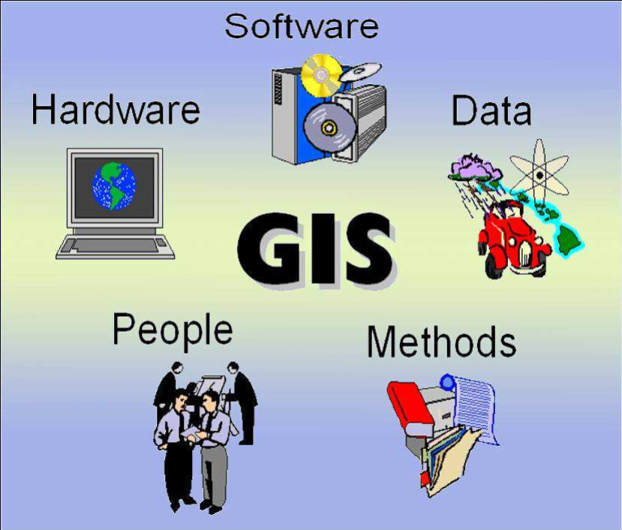
Components of GIS
GIS consists of 5 key components:

Slide 23
Components of GIS
Hardware: it consists of a computer system on which the GIS software will run.
Software: GIS software provides the functions and tools needed to store, analyze, and display geographic information.
People: GIS users range from technical specialists who design and maintain the system to those who use it to help them perform their everyday work.

Slide 24
Components of GIS
Method: a successful GIS operates according to a well-designed plan and business rules, which are the models and operating practices unique to each organizations.
Data: Geographic data and related tabular data that can be collected in-house. Digital map forms the basic data input for GIS.

Slide 25
Data Types in GIS
The data in a GIS can be classified into two main categories:
1. Spatial data
Describes the absolute and relative location of geographic features.
2. Attribute data or Non-spatial data
Describes characteristics of the spatial features. These characteristics can be quantitative and/or qualitative in nature.

Slide 26
The Data Model
Data model is a conceptual description (mental model) of how spatial data are organized for use by the GIS.
The data model represents a set of guidelines to convert the real world (called entity) to the digitally and logically represented spatial objects consisting of the attributes and geometry.
The attributes are managed by thematic or semantic structure while the geometry is represented by geometric-topological structure.

Slide 27
The Data Model
There are two major types of geometric data model; vector and raster model.
a. Vector Model
Vector model uses discrete points, lines and/or areas corresponding to discrete objects with name or code number of attributes.
b. Raster Model
Raster model uses regularly spaced grid cells in specific sequence. An element of the grid cell is called a pixel (picture cell). The conventional sequence is row by row from the left to the right and then line by line from the top to bottom. Every location is given in two dimensional image coordinates ; pixel number and line number, which contains a single value of attributes.

Slide 28
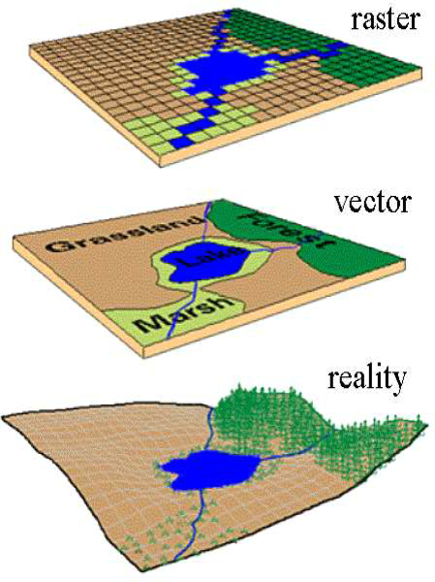
Concept of Vector and Raster

Slide 29
Data models in GIS
RASTER DATA MODEL
VECTOR DATA MODEL
TRIANGULATED IRREGULAR NETWORK MODEL(TIN)
DIGITAL ELEVATION MODEL (DEM)
NETWORK MODELS

Slide 30
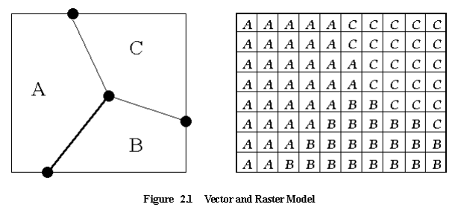
Data Model & Structure
The data model represents a set of guidelines to convert the real world (called entity) to the digitally and logically represented spatial objects consisting of the attributes and geometry. The attributes are managed by thematic or semantic structure while the geometry is represented by geometric-topological structure.
There are two major types of geometric data model ; vector and raster model, as shown in Figure.

Slide 31
Geometry and Topology of Vector Data
Spatial objects are classified into point object such as meteorological station, line object such as highway and area object such as agricultural land, which are represented geometrically by point, line and area respectively.
For spatial analysis in GIS, only the geometry with the position, shape and size in a coordinate system is not enough but the topology is also required.
Topology refers to the relationships or connectivity between spatial objects.

Slide 32
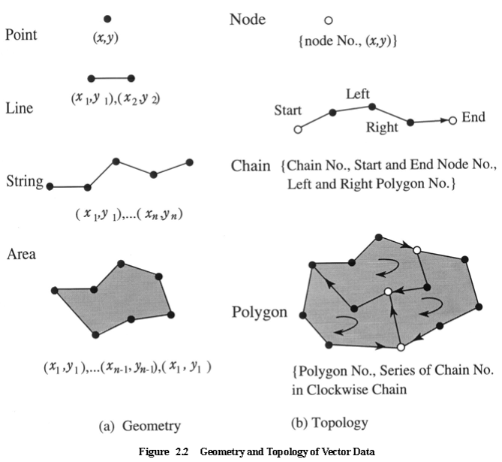
Geometry and Topology of Vector Data
The geometry of a point is given by two dimensional coordinates (x, y), while line, string and area are given by a series of point coordinates, as shown in Figure (a). The topology however defines additional structure as follows (see Figure (b)).

Slide 33
Geometry and Topology of Vector Data
Node: an intersect of more than two lines or strings, or start and end point of string with node number
Chain: a line or a string with chain number, start and end node number, left and right neighboured polygons
Polygon: an area with polygon number, series of chains that form the area in clockwise order (minus sign is assigned in case of anti-clockwise order)

Slide 34
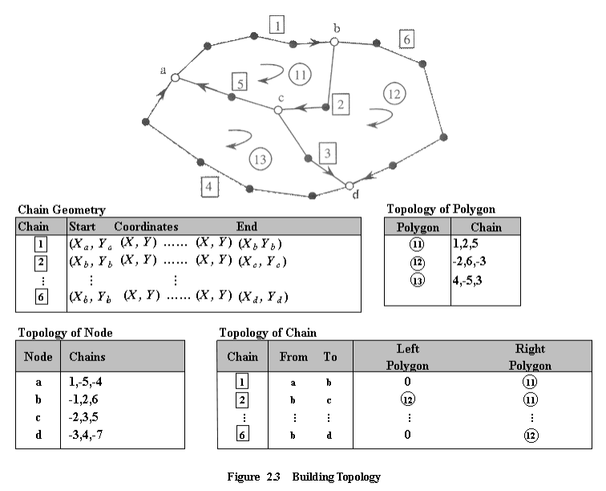
Topological Data Structure
In order to analyse a network consisting of nodes and chains, the following topology should be built.
Chain: Chain ID, Start Node ID, End Node ID, Attributes
Node: Node ID, (x, y), adjacent chain IDs (positive for to node, negative for from node)
In order to analyse not only a network but also relationships between polygons, the following additional geometry and topology are required as shown in an example of Figure.

Slide 35
Topological Data Structure
Chain geometry: Chain ID, Start Coordinates, Point Coordinates, End Coordinates
Polygon topology : Polygon ID, Series of Chain ID, in clockwise order (Attributes)
Chain topology : Chain ID, Start Node ID, End Node ID, Left Polygon ID, Right Polygon ID, (Attributes)

Slide 36
Topological Data Structure
The advantages of the topological data model are to avoid duplication in digitizing common boundaries of two polygons and to solve problems when the two versions of the common boundary do not coincide.
The disadvantages are to have to build very correct topological data sets without any single error and to be unable to represent islands in a polygon.

Slide 37
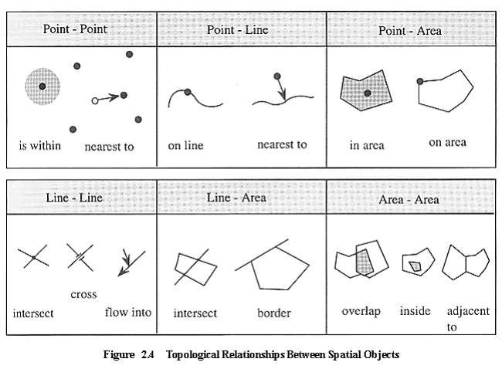
Topological Relationships between Spatial Objects
In practical applications of GIS, all possible relationships in spatial data should be used logically with more complicated data structures.
The following topology relationships are commonly defined.
a. Point-Pont Relationship
"is within”: within a certain distance
"is nearest to”: nearest to a certain point

Slide 38
Topological Relationships between Spatial Objects
The following topology relationships are commonly defined.
b. Point-Line Relationships
"on line”: a point on a line
"is nearest to”: a point nearest to a line
c. Point-area Relationships
"is contained in: a point in an area
"on border of area”: a point on border of an are

Slide 39
Topological Relationships between Spatial Objects
The following topology relationships are commonly defined.
d. Line-Line Relationships
"intersects”: two lines intersect
"crosses" : two lines cross without an intersect
"flow into" : a stream flows into the river
e. Line-Area Relationship
"intersects" : a line intersects an area
"borders" : a line is a part of border of an area

Slide 40
Topological Relationships between Spatial Objects
The following topology relationships are commonly defined.
f. Area-Area Relationships
"overlaps”: two areas overlap
"is within”: an island within an area
"is adjacent to”: two area share a common boundary

Slide 41
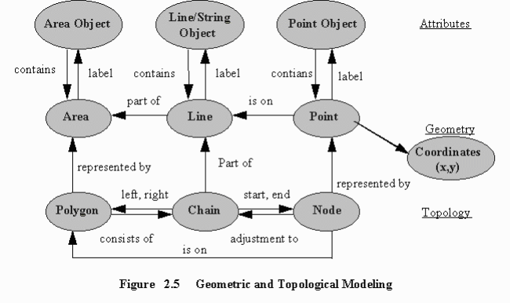
Topological Relationships between Spatial Objects

Slide 42
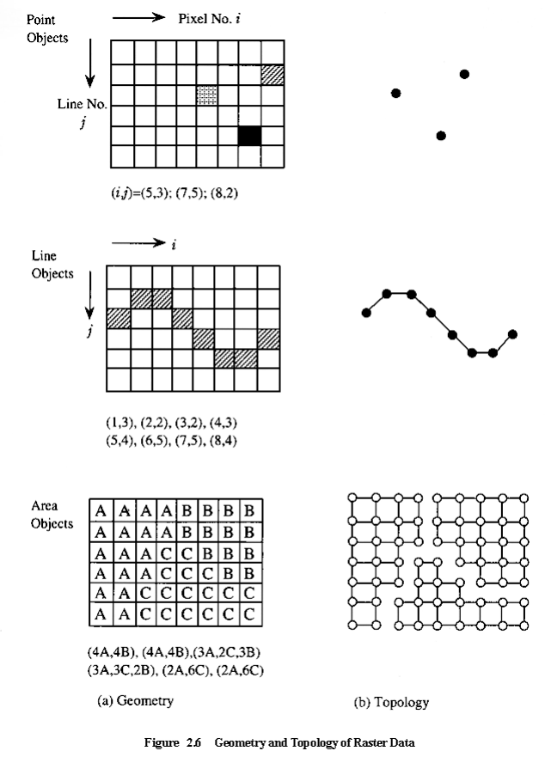
Geometry and Topology of Raster Data
The geometry of raster data is given by point, line and area objects as follows (see Figure (a)).
a. Point objects
A point is given by point ID, coordinates (i, j) and the attributes
b. Line object
A line is given by line ID, series of coordinates forming the line, and the attributes

Slide 43
Geometry and Topology of Raster Data
The geometry of raster data is given by point, line and area objects as follows (see Figure (a)).
c. Area objects
An area segment is given by area ID, a group of coordinates forming the area and the attributes. Area objects in raster model are typically given by "Run Length" that rearranges
the raster into the sequence of length (or number of pixels) of each class as shown in Figure (a).

Slide 44
Geometry and Topology of Raster Data
The topology of raster model is rather simple as compared with the vector model as shown Figure (b).
The topology of line objects is given by a sequence of pixels forming the line segments.
The topology of an area object is usually given by "Run Length" structure as follows.
- start line no., (start pixel no., number of pixels)};
- second line no., (start pixel no., number of pixels)};

Slide 45
Topological Features of Raster Data
One of the weak points in raster model is the difficulty in network and spatial analysis as compared with vector model.
For example, though a line is easily identified as a group of pixels which form the line, the sequence of connecting pixels as a chain would be a little difficult in tracing.
In case of polygons in raster model, each polygon is easily indentified but the boundary and the node (when at least more than three polygons intersect) should be traced or detected.

Slide 46
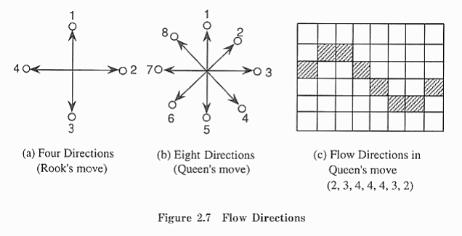
Topological Features of Raster Data
Flow directions
A line with directions can be represented by four directions called as the Rook's move in the chess game or eight directions called as the Queenís move, as shown in Figure (a) and (b).
Figure (c) shows an example of flow directions in the Queen's move. Water flow, links of a network, roads etc. can be represented by the flow directions (or called Freeman chain code).

Slide 47
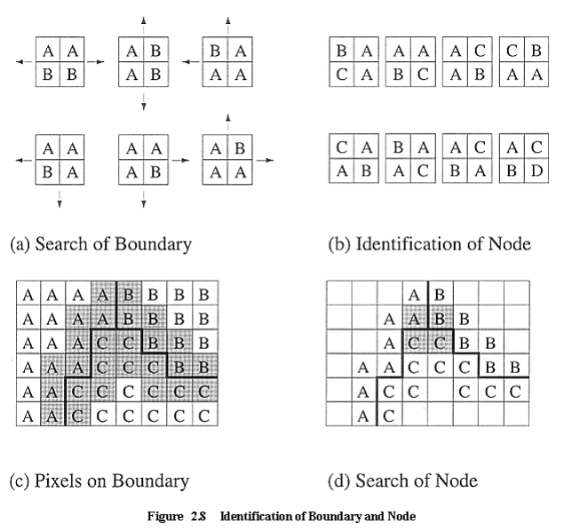
Topological Features of Raster Data
Boundary is defined as 2 x 2 pixel window that has two different classes as shown in Figure (a). If a window is traced in the direction shown in Figure (a), the boundary can be identified.

Slide 48
Topological Features of Raster Data
Node
A node in polygon model can be defined as a 2 x 2 window that has more than three different classes as shown in Figure (b).
Figure (c) and (d) show an example of identification of pixels on boundary and node.

Slide 49
Vectorization
Comparing raster and vector data is like comparing apples and oranges; in order to analyze and draw conclusions from GIS data, it has to be integrated.
Photographs, satellite imagery, and scanned files will typically start in raster format, so they’ll likely need to be converted into vectors to be used - a process referred to as vectorization.
Converting pixels to points can take a great deal of time by hand, but luckily, GIS software can help speed up the process.

Slide 50
Vectorization
One situation where vectorization may be necessary is when using an aerial photograph to create a property map. In this case, the process could look like the following:
Step 1. Scan the aerial photograph
Step 2. Upload the scanned photo to GIS software
Step 3. Vectorize the photograph (converting it from pixels to polygons)
Step 4. Create a map layer with the vector data
Once the GIS software has created a map layer with the photo data, it can determine the area of features, measure the distance between objects, and make other conclusions of a similar nature.

Slide 51
Vectorization
One situation where vectorization may be necessary is when using an aerial photograph to create a property map. In this case, the process could look like the following:
Step 1. Scan the aerial photograph
Step 2. Upload the scanned photo to GIS software
Step 3. Vectorize the photograph (converting it from pixels to polygons)
Step 4. Create a map layer with the vector data
Once the GIS software has created a map layer with the photo data, it can determine the area of features, measure the distance between objects, and make other conclusions of a similar nature.

Slide 52
Process
While there’s no shortage of public data, there’s also little to no standardization, making it difficult to find data in the right format. However, just because data isn’t formatted correctly doesn’t necessarily mean it’s unusable - it just needs to be translated.
There are two main components to translating data for GIS software, syntactic and semantic translation. Syntactic translation is by far the easier of the two, as it only involves translating symbols such as letters and numbers between systems. Semantic translation, on the other hand, is a bit more complicated. It aims to decipher the meaning behind the data, and though progress has been made, semantic translation tends not to be very accurate.

Slide 53
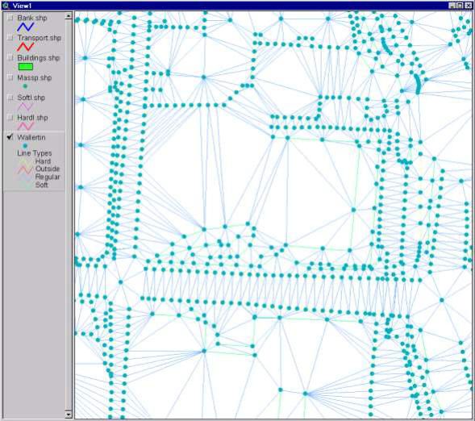
Triangulated Irregular Network (TIN)
TIN stands for Triangular Irregular Network, which is a vector approach to handling a digital elevation model. TIN’s are used to interpolate surfaces using multiple triangles.
TIN’s are able to interpolate surfaces by selecting representative points that are usually data points. TIN’s connect these points to form a set of continuous and connected triangles. The data points consist of X, Y and Z values. The final result gives users a TIN surface.

Slide 54
Advantages of TIN
TIN’s give researchers the ability to view 2.5D and 3D at an area that was interpolated from minimal data collection.
Users can describe a surface at different levels of resolution based on the points that were collected.
TIN interpolation gives GIS users greater analytical capabilities. TIN models are easy to create and use.
They provide users a simplified model that represents collected data points.
Using a TIN surface in conjunction with ArcMap extensions such as Spatial Analysis and 3D Analyst, TIN users can also derive slope, aspect, elevation,
contour lines, hillshades, etc.

Slide 55
Different Types of TIN Methods and Processes
There are many different types of TIN interpolation methods. Some of the most popular TIN methods include
Natural Neighbour,
Krigging,
Spline,
Nearest Neighbour and
Inversed Distance Weighting.
These TIN interpolation methods use mathematical algorithms in order to generate interpolated surfaces. Each of these methods will produce different types of surfaces.

Slide 56
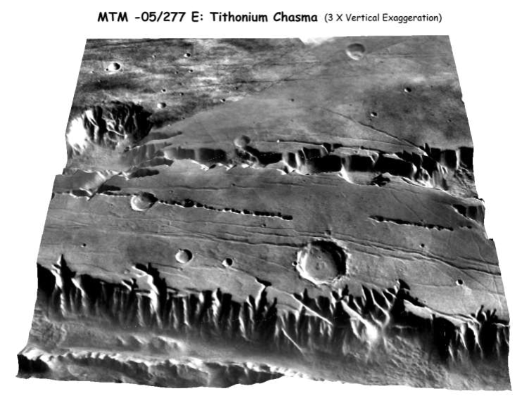
Digital Elevation Model (DEM)
Digital Elevation Model is a data model which represents the surface of a terrain in 3 dimension.
DEM can be represented as a raster or as TIN.
The TIN DEM dataset is also referred to as a primary DEM or measured DEM.
Raster DEM is referred to as secondary DEM or computed DEM.
3D rendering of DEM of Tithonium Chasma on Mars

Slide 57
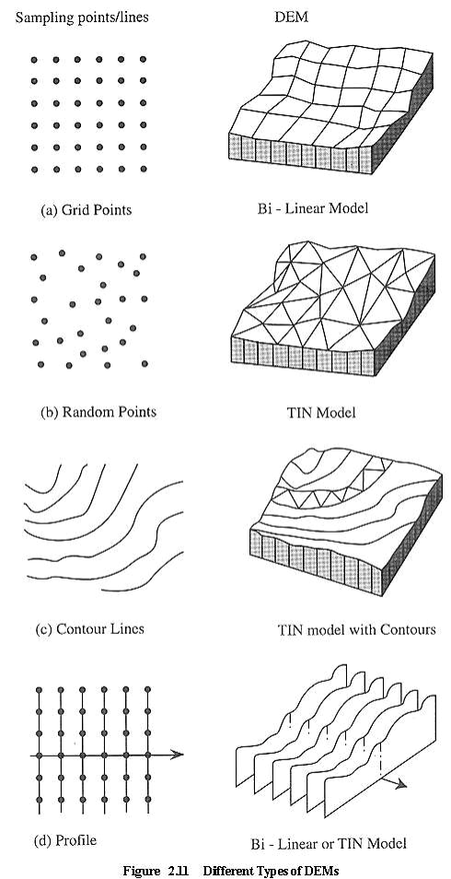
Types of DEM

Slide 58
Spatial Analysis
answer questions, support decisions, and reveal patterns
all of the transformations, manipulations, and methods
Data ----> Information ---> Understanding
"a set of methods whose results change when the locations of the objects being analyzed change"

Slide 59
Which is Spatial Analysis?
calculating the average income for a group of people?
calculating the center of the United States population?

Slide 60
Types of Spatial Analysis
Queries and reasoning
Measurements
Aspects of geographic data, length, area, etc.
Transformations
New data, raster to vector, geometric rules
Descriptive summaries
Essence of data in 1 or 2 parameters
Optimization - ideal locations, routes
Hypothesis testing - sample to entire pop.

Slide 61
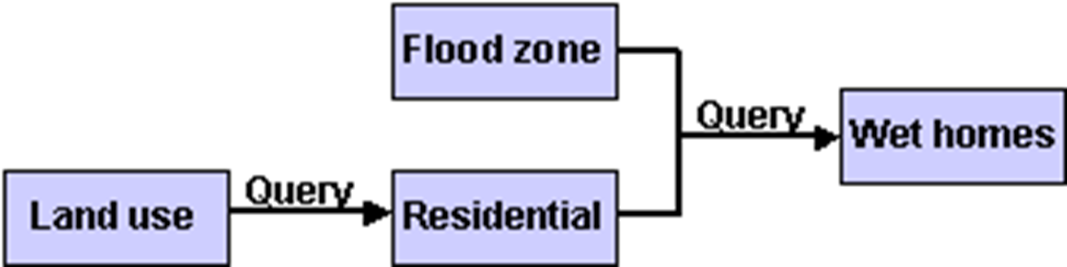
GIS Analysis Model (flowchart)
Residential areas in flood zone BUT need spatial analysis to pinpoint locations

Slide 62
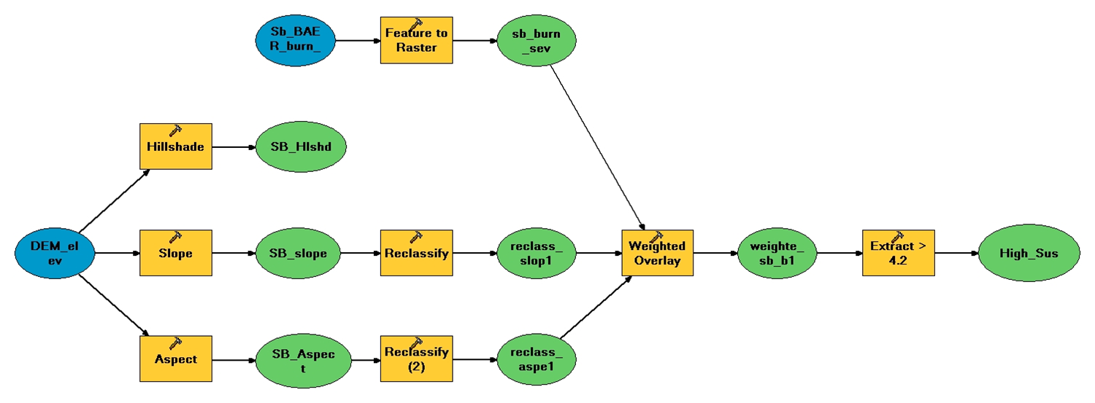
GIS Lanslide Susceptibility Model in ArcGIS Model Builder

Slide 63
2 Analysis Examples from ArcGIS
Interpolation - soil samples on a farm [transformation]
Location Analysis - coffee shops & customers [optimization]

Slide 64
Thematic Data Modelling
The real-world entities are so complex that they should be classified into object classes with some similarity through thematic data modelling in a spatial database.
The objects in a spatial database are defined as representations of real-world entities with associated attributes.
Generally, geospatial data have three major components; position, attributes and time. Attributes are often termed "thematic data" or "non-spatial data", that are linked with spatial data or geometric data

Slide 65
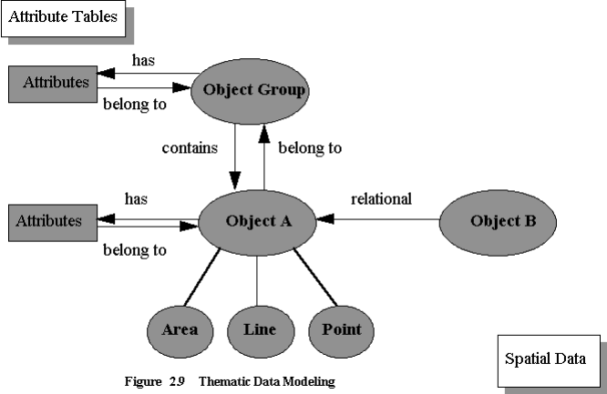
Thematic Data Modelling
An attribute has a defined characteristic of entity in the real world.
Attribute can be categorized as normal, ordinal, numerical, conditional and other characteristics. Attribute values are often listed in attribute tables which will establish relationships between the attributes and spatial data such as point, line and area objects, and also among the attributes.

Slide 66
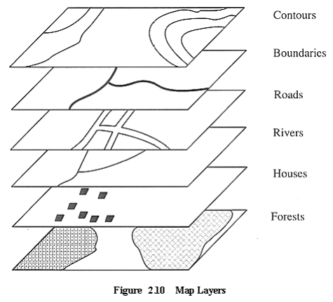
Thematic Data Modelling
Spatial objects in digital representation can be grouped into layers as shown in Figure.
For example, a map can be divided into a set of map layers consisting of contours, boundaries, roads, rivers, houses, forests etc.

Slide 67
Data Structure for Continuous Surface Model
In GIS, continuous surface such as terrain surface, meteorological observation (rain fall, temperature, pressure etc.) population density and so on should be modelled. As sampling points are observed at discrete interval, a surface model to present the three-dimensional shape; z = f (x, y) should be built to allow the interpolation of value at arbitrary points of interest.
Usually the following four types of sampling point structure are modelled into DEM.

Slide 68

Data Structure for Continuous Surface Model
Grid at regular intervals:
Bi-linear surface with four points or bi-cubic surface with sixteen points is commonly used
Random points:
Triangulated irregular network (TIN) is commonly used. Interpolation by weighted polynomials is also used.

Slide 69
Data Structure for Continuous Surface Model
Contour lines:
Interpolation based on proportional distance between adjacent contours is used. TIN is also used.
Profile:
Profiles are observed perpendicular to an alignment or a curve such as high ways. In case the alignment is a straight line, grid points will be interpolated. In case the alignment is a curve, TIN will be generated.

Slide 70

Myself
Dr. Giri Rajasekhar Gunnu
AI, Digital Twin & Industry Solutions Specialist | Industry 4.0 Specialist | Predictive Solutions Expert | Marine and Offshore Consultant
Professor of Practice, Andhra University
📧 g.giri.iitm@gmail.com
🔗 LinkedIn: girigunnu

Slide 71
Q&A
Welcome your questions and insights from all ranks
Your feedback helps us improve our CBPM implementation and ensures it meets the real-world needs of our fleet

